Slide 1
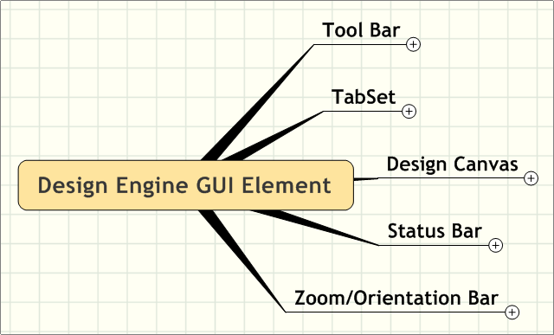
Design Engine GUI Element

Slide 2
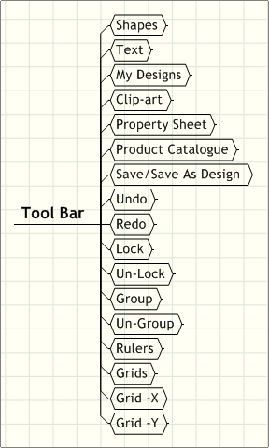
Tool Bar

Slide 3
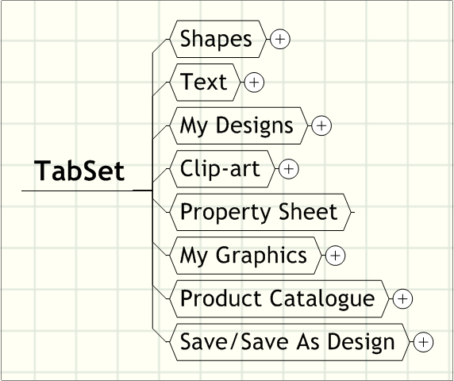
Tab Set

Slide 4
Shapes
Pointer/Normal
Circle
Ellipse
Line
Rectangle
Polygon
Poly Line
Quadratic Bezier Curve
Cubic Bezier Curve

Slide 5
Text
Text
Font
  Font Size
  Font Type
  Font Weight
  Font Style
    Italic
    Under Line
    Strike Through
Background Color
  RGB Color
  SVG Color
Foreground Color
  RGB Color
  SVG Color

Slide 6
My Designs
Category Tree
Designs

Slide 7
Clip-art
Category Tree
Clip-arts

Slide 8
My Graphics
Category Tree
Graphic Images

Slide 9
Product Catalogue
Category Tree
Products

Slide 10
Save/Save As Design
Save
  Design Name
  Your E-mail Id
Save As
  Design Name

Slide 11
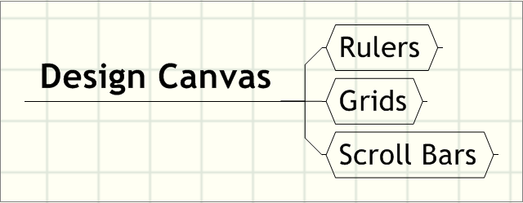
Design Canvas

Slide 12
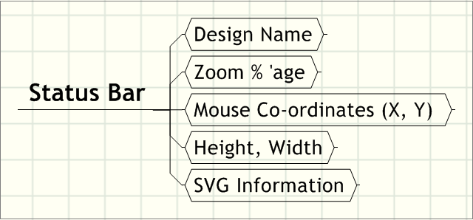
Status Bar

Slide 13
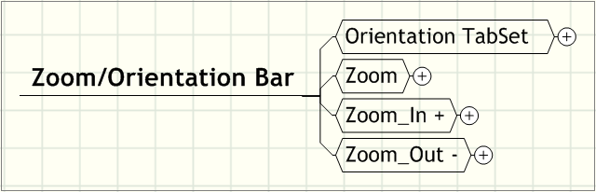
Zoom/Orientation Bar

Slide 14
Orientation Tab Set
Front, Back, Top etc

Slide 15
Zoom
10% to 1000%

Slide 16
Zoom_In +
Up to 1000%

Slide 17
Zoom_Out -
Down to 10%

